Slide 1


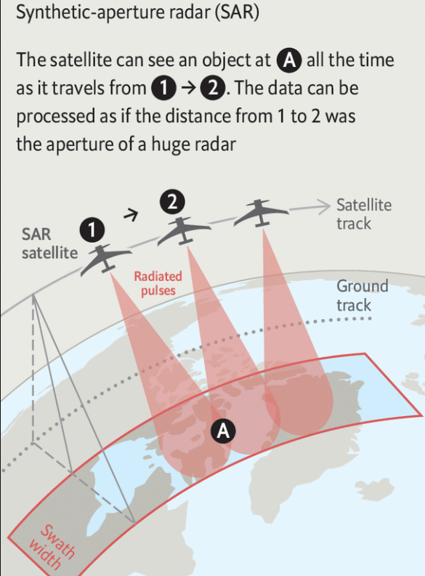
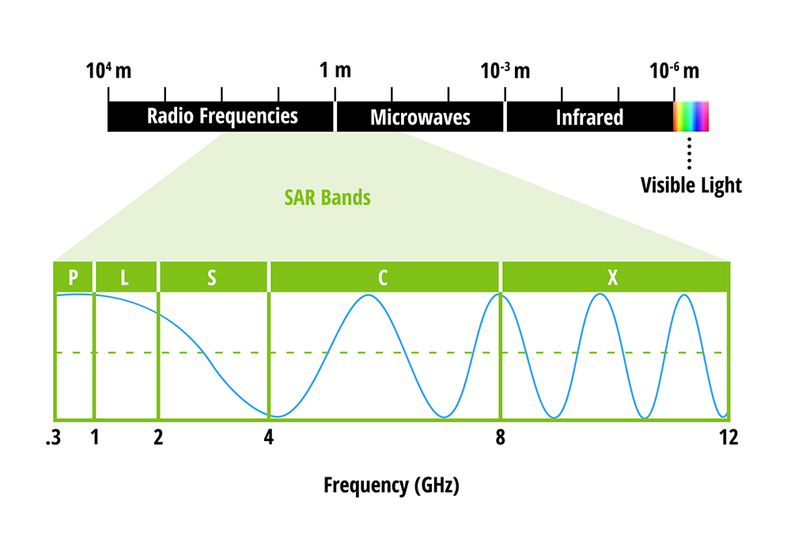
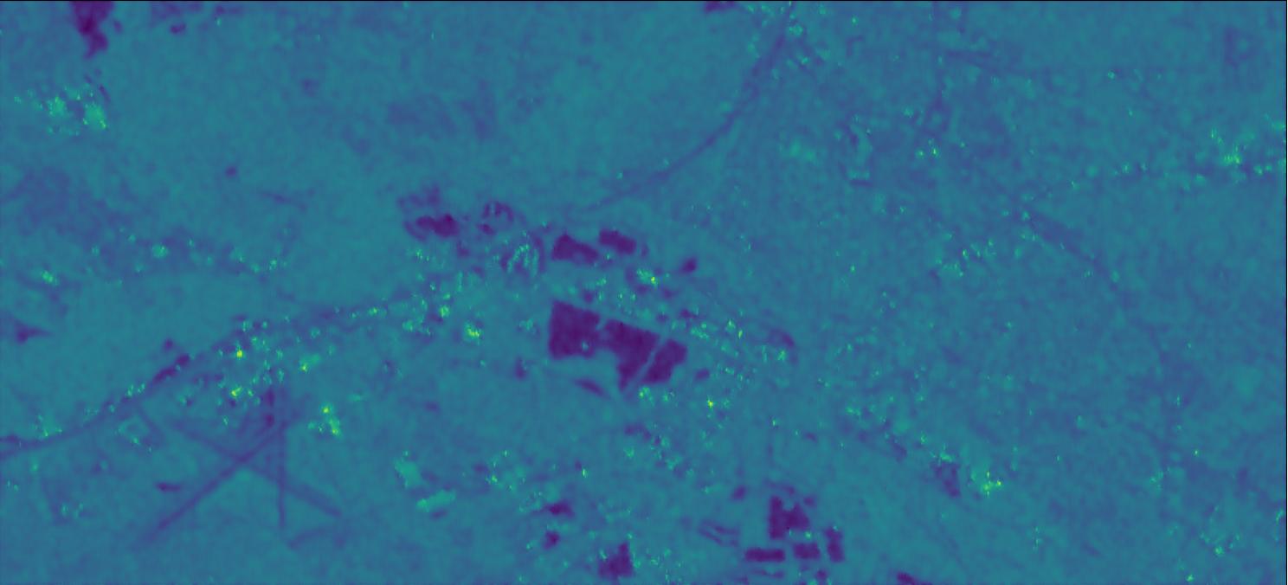

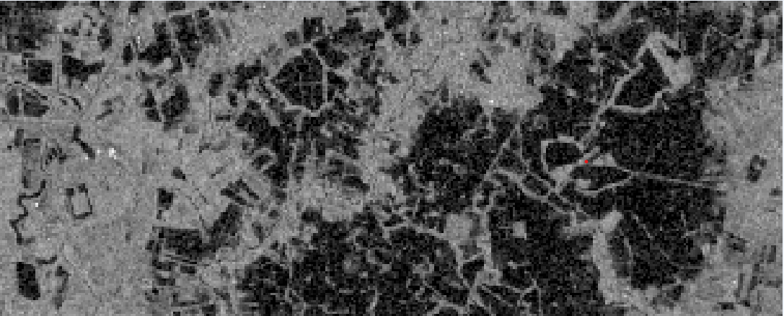
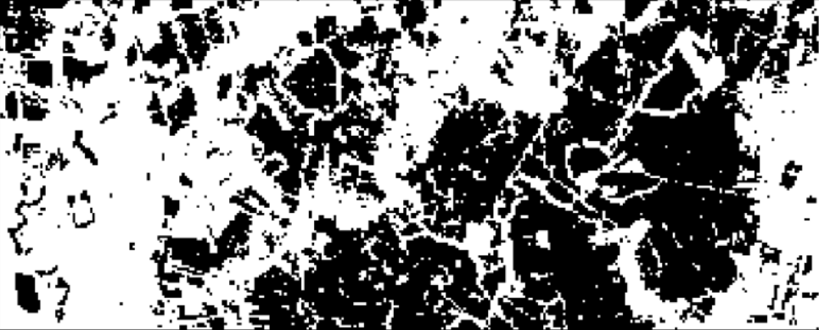
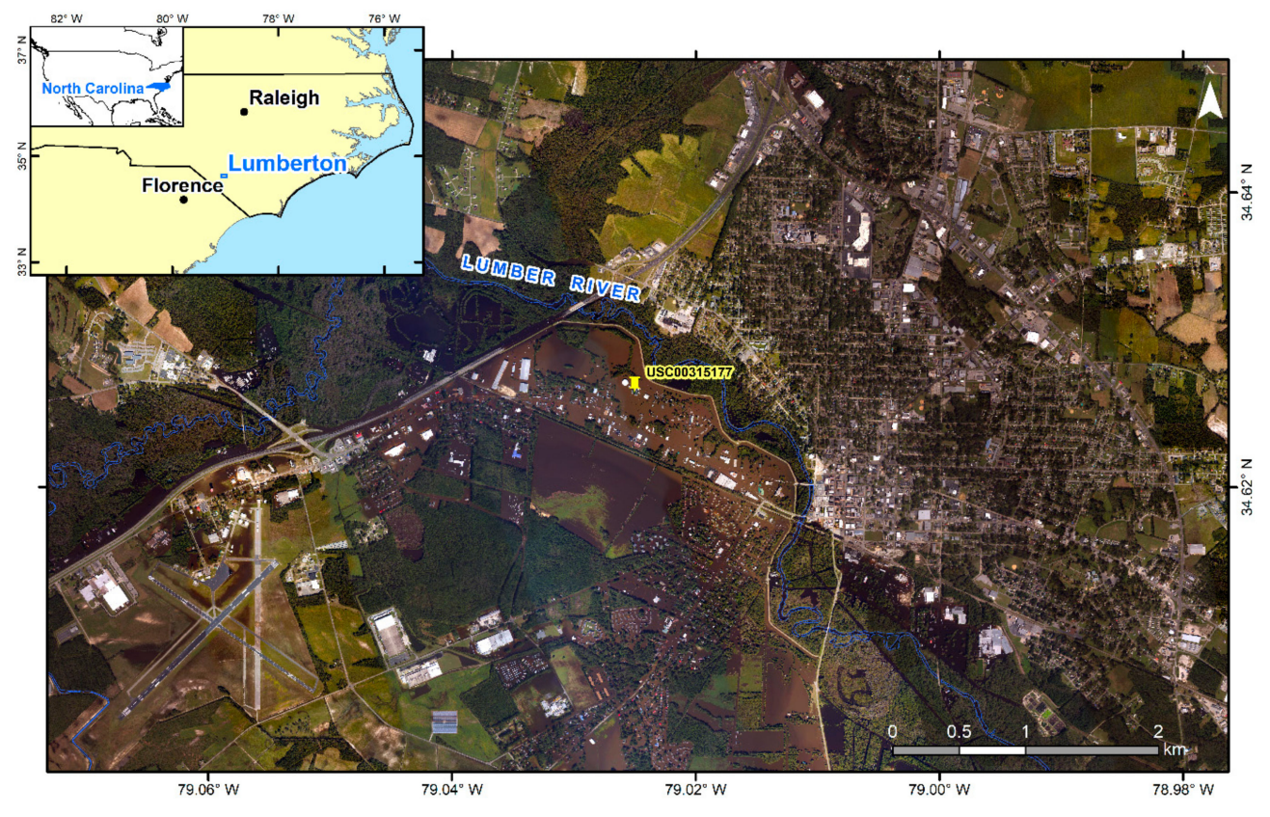
Abdul Rehman, Department of Computer Science Engineering, Sant Longowal Institute of Engineering and Technology, Punjab, India
B8
Identification of flood extents using Synthetic Aperture Radar images
Under the supervision of Alok Bhardwaj, Mehta family School of Data Science and Artificial Intelligence, IIT Roorkee
Introduction and Motivation
Methodology
Syntha
Flood extent maps based on synthetic aperture radar (SAR) have increasingly been used in recent emergency response operations.
In the Sentinel Asia consortium, where researchers worked on emergency observation requests in the Asia-Pacific region, the responses to 20 of 23 activated flood-related events in the year 2017 used ALOS-2 SAR flood-mapping results [1].
These statistics demonstrate the need for radar’s all-weather, day-and-night sensing capability, where in most cases cloud cover and rains persist for the duration of a flood.
SAR input image of flooded area
Binarization of SAR image
Drawing points on Intensity drops and intensity jumps
output
Drawing Contours around it
Detecting all the continuous points and closed shapes in image
(a)
(b)
Result
Input
Output
Figure 1
Signals form SAR satellite combines in a uique way to form images of the Earth’s surface
Study Area and Data
On 8 October 2016, Hurricane Matthew made landfall on the southeast coast of South Carolina and slowly moved northwards into North Carolina.
Lumberton, Robeson County, is located on the Coastal Plains of North Carolina, with an average elevation of 40 m.
The Lumber River flows right through the middle of the town.
Validation Dataset:
Radar intensity data contain more complicated responses than a simple binary dissection between wet and dry areas. We, therefore, decided to create a validation dataset that also honored possible SAR. We manually classified the during-flood aerial image into the following two classes.
Flooded Region and Not Flooded region
Flooded area is detected successfully and contours are drawn around it.
This approach works on real-time data, therefore we can determine the area of the flooded region (area of contour) instantly using the ratio of pixel to meter squared.
Conclusions and Future Work
Flood Detection: Flood is successfully detected in single SAR amplitude image…
Determining the Real-time Area under flood…
….
Future Work:
Ability to detect flood, dry vegetation, dry, flooded vegetation, and permanent water from the same image.
References
Sentinel Asia. Sentinel Asia Sentinel Asia Annual Report 2017; Japan Aerospace Exploration Agency: Tokyo, Japan, 2019;
Yunung Nina Lin; Sang-Ho Yun; Alok Bhardwaj; Emma M. Hill,(2019) Urban Flood Detection with Sentinel-1 Multi-Temporal Synthetic Aperture Radar (SAR) Observations in a Bayesian Framework: A Case Study for Hurricane Matthew, Remote Sens. 11, 1778
Kelsey Herndon; Franz Meyer; Africa Flores; Emil Cherrington; and Leah Kucera in collaboration with the Earth Science Data Systems:https://www.earthdata.nasa.gov/learn/backgrounders/what-is-sar
Synthetic-aperture radar is making the Earth’s surface watchable 24/7:https://www.economist.com/technology-quarterly/2022/01/27/synthetic-aperture-radar-is-making-the-earths-surface-watchable-24/7
Figure 2: Lumberton in Robeson County, North Carolina, and the during-event airborne optical imagery taken on 11 October 2016. The Lumber River flows right through the middle of the town.[2]
Acknowledgements
The author would like to thank the European Space Agency for providing Sentinel-1 datasets. Also, the author is very much grateful to the SPARK committee of the Indian Institute of Technology Roorkee for providing the necessary infrastructure to carry out this research work. The author would also like to thank “Dr. Alok Bhardwaj” for guiding and supervising during Research Internship.
SPARK 2022:Summer Internship Program, IIT Roorkee

